Slide 1
Data Set Building

Slide 2
Data Acquisition
In the manufacturing plant, technician will record their manual inspection observation in excel sheet. This will serves as the classification data.
Resistance measurement result will be saved in company database by automatic probe testing equipment and it is retrievable in csv format. This will serves as input image.

Slide 3
Data Acquisition
After consulting subject matter expert, we found that
Technician Observation | Features
Normal | Scattering
Saw | Small scratch at the edge (not deep into the wafer, <45 degree). Failing edge parts in small angle. Need annotation of the direction of failing edge
Grind | Involves only edge in wider angle (>30 degree). Failing edge parts in large angle. Need annotation of the direction of failing edge.
Material | It usually fails in an obvious closed region in circle, horseshoe bend, doughnut, cluster. It might hit edge area but usually deep into the material.
Combination | Any combination can take place simultaneously.

Slide 4
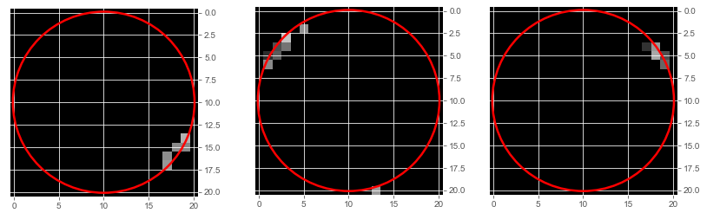
Saw Image Acquisition based on annotation

Slide 5
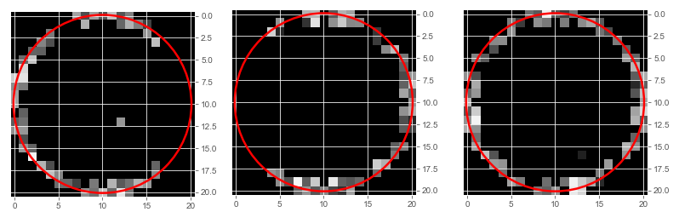
Grind Image Acquisition based on annotation

Slide 6
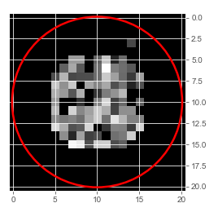
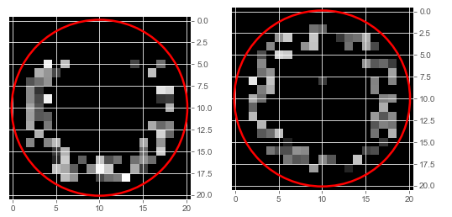
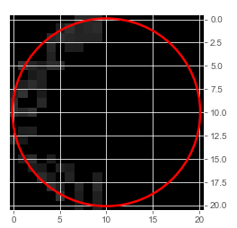
Material Issue – Based on failing patterns

Slide 7
Data Acquisition
Based on the consultation, pulling resistance data and observation excel sheet from company database for each possible failing pattern. Each pattern will have at least 10 wafer data to support it. (See ID_Selected.xlsx for more details)
As a result, 1090 wafer ID are selected.

Slide 8
Data Wrangling
After getting 1090 wafer IDs, resistance measurement data are obtained from company database. The raw data is in csv format. (see raw_data.csv)
Technician observation data are obtained in excel format. (see TechnicianObservationData.xlsx)
The two files are compiled into final data td6.xlsx.
Each line represents all resistance data with its classification result.

Slide 9
Data Cleansing and Processing
IDs are removed from the database, hence the result are ready to be used for the deep neural network.
Panda is used to extract the data from excel sheet.
Inputs are output are then extracted as panda dataframe.
20% test train split is applied on the data.
Convert the split data into numpy array.
The array is then scaled. Since 500ohm is the measurement limit, all the data is divided with 500.

Slide 10
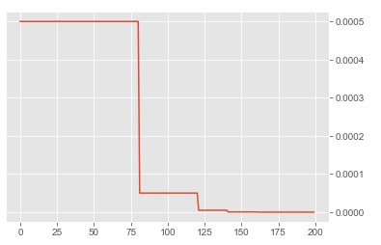
Learning Rate
Set the learning rate to 0.5e-3 at the beginning. Then reduce the learning rate in step shown below:
Learning Rate
Epoch

Slide 11
